Slide 1










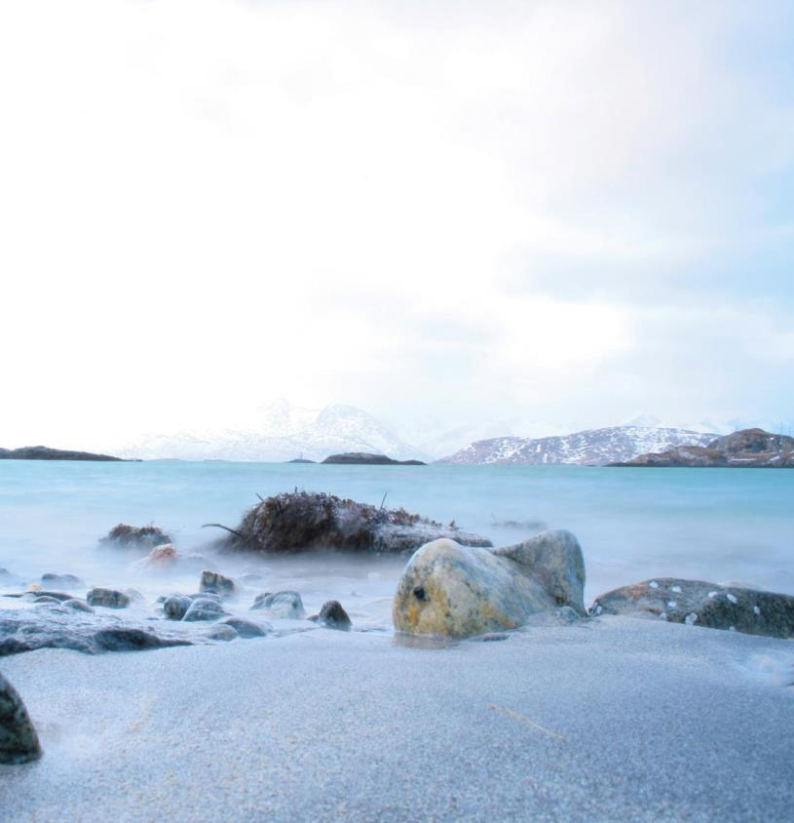
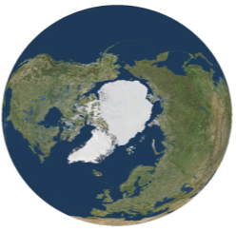

The Arctic Spatial Data Infrastructure (Arctic SDI)
A collaboration between the Arctic Council and the national mapping authorities of the Arctic
Need
Integrated maps and applications covering the Arctic region that gives arctic politicians, governments, scientists, schools, private enterprises and citizens access to geographically related thematic data, digital maps and tools
What is The Arctic SDI?
The National Mapping Agencies of the member states of the Arctic Council are collaboratively developing data, policies, technologies and standards
Benefits
Improve basis for decision making, through the provision of facts to better facilitate economic development, integrated planning, developing infrastructures and performing search and rescue operations, while managing impacts on the Arctic environment and society
Data
Collaboration
Standards
Policies
Collaboration
Technology
Arctic SDI Vision
An Arctic SDI - based on sustainable co-operation between mandated national mapping organisations -will provide for access to spatially related reliable information over the Arctic to facilitate monitoring and decision making.
Mission
To provide the best Geodata in the Arctic and support tools for data discovery, access and sharing.
www.arctic-sdi.org
Arctic
SDI
info@arctic-sdi.org

Slide 2
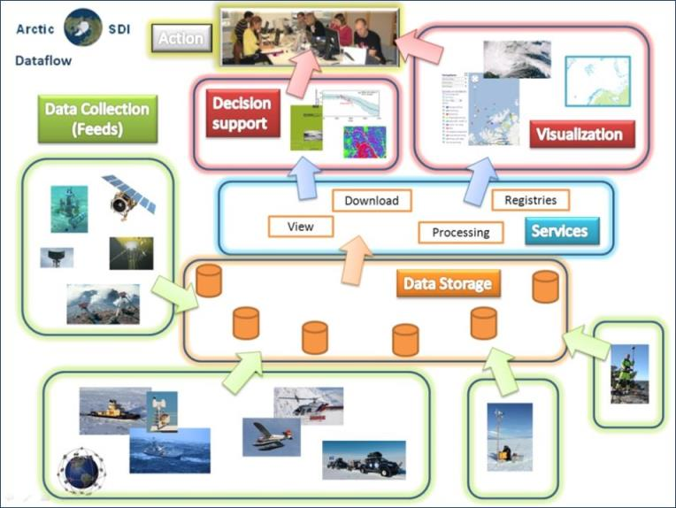
The Arctic Spatial Data Infrastructure (Arctic SDI)
A collaboration between the Arctic Council and the national mapping authorities of the Arctic
Data flow in the Arctic SDI from Collection to Action
www.arctic-sdi.org
Arctic
SDI
info@arctic-sdi.org

Slide 3
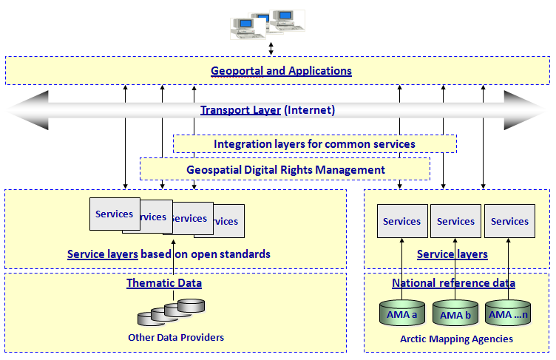
The Arctic Spatial Data Infrastructure (Arctic SDI)
A collaboration between the Arctic Council and the national mapping authorities of the Arctic
The Arctic SDI Technical Architecture.
The Arctic SDI must be seen in the context of domestic realities and complement the UN-GGIM, INSPIRE, ELF, NSDI and CGDI activities.
www.arctic-sdi.org
Arctic
SDI
info@arctic-sdi.org

Slide 4
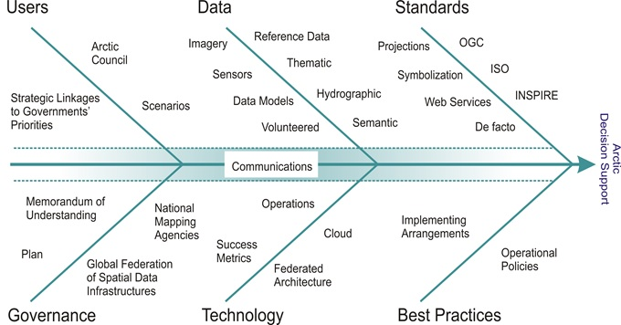
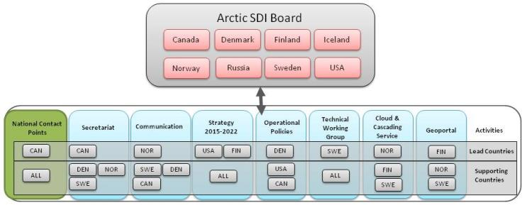
The Arctic Spatial Data Infrastructure (Arctic SDI)
A collaboration between the Arctic Council and the national mapping authorities of the Arctic
The Arctic SDI Reference Model with the purpose to aid strategic Arctic SDI discussions by grouping existing and potential SDI components. All Arctic SDI activities link to the Reference Model.
The Arctic SDI corporation is based upon a Memorandum of Understanding and the organizational structure is based on activities that are being carried out by the participating National Mapping Agencies on a voluntary basis
www.arctic-sdi.org
Arctic
SDI
info@arctic-sdi.org

